Slide 1


Weather Influences on the Flu
Beth Emborsky
Brodie Armstrong
Mark Alcocer

Slide 2
“Climate is what we expect, weather is what we get.”
- Mark Twain
Notes:
With the global pandemic of Covid-19, we wanted to look and see how weather in the past has influenced cases of the flu

Slide 3
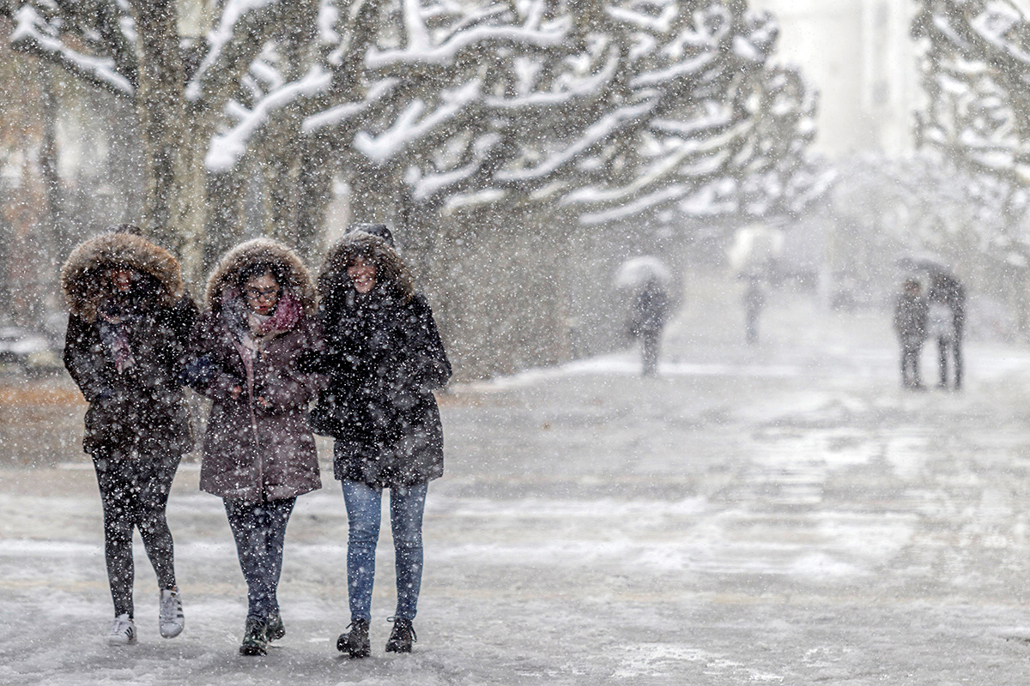

Weather Impact on Influenza Outbreaks
Our project is to uncover patterns in influenza case breakouts based on weather patterns. We’ll examine relationships between types of influenza and location; trends in influenza over the course of the year; and related questions, as the data admits.

Slide 4
Questions & Data
What is the relationship between flu and temperature?
What is the relationship between flu and other weather parameters (e.g. humidity, precipitation totals)?
Is there a common relationship amongst different types of flu?

Slide 5


Data Sources
Weekly flu data from the CDC & WHO at the state level in csv format
Daily observed average temperature and precipitation from The Weather Company in csv format
We focused on 11 large US cities that were scattered across the country
Atlanta, Chicago, Dallas, Denver, Houston, Los Angeles, New York, Philadelphia, Phoenix, San Francisco, Seattle
We averaged the daily observed average temperatures to compare to our weekly CDC number
State level CDC data was compared to large cities in that state

Slide 6
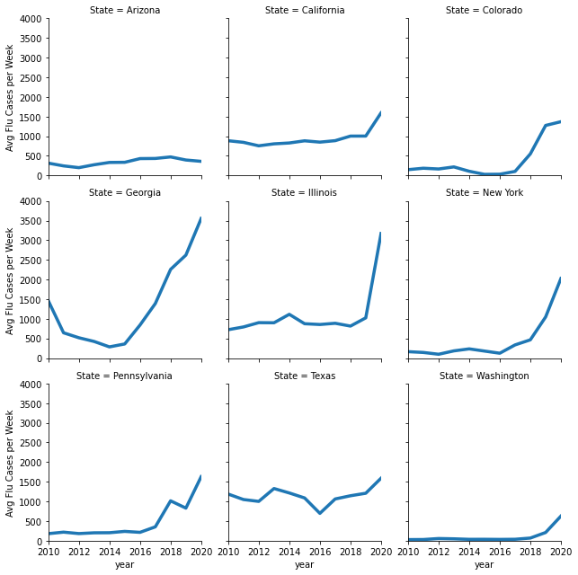
CDC Flu Weekly Data
Flu reporting is voluntary and varies widely by state to state
CDC publishes weekly Total ILI (Influenza like Illness) and positive cases
100 public health and 300 clinical Laboratories report to the CDC
ILI Flu Cases are not population weighted and some areas are over reported (CDC is headquartered in Atlanta)

Slide 7
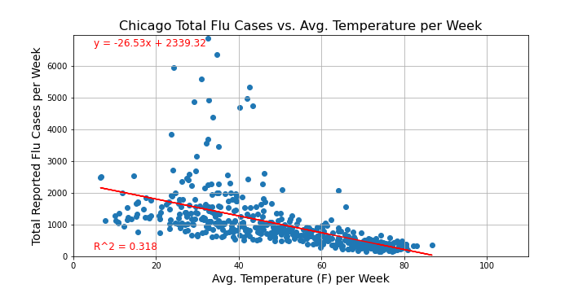
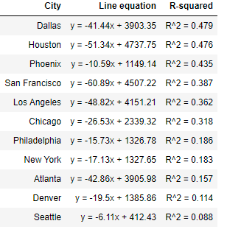
Analysis
Scatter Plots show clear relationship between Temperature and Flu cases
Reporting has increased overtime(see previous slide). Individual R^2 would be higher in certain year but we kept
Certain Cities had a much higher R^2

Slide 8
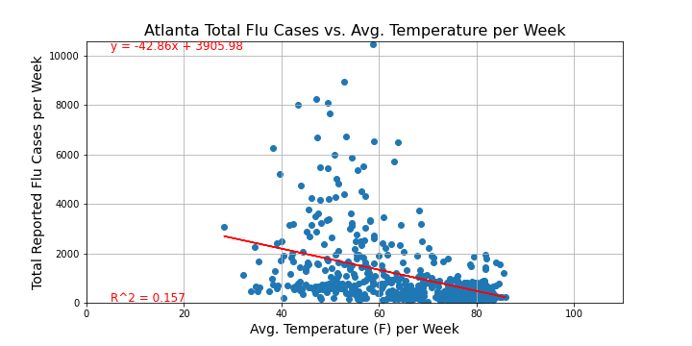
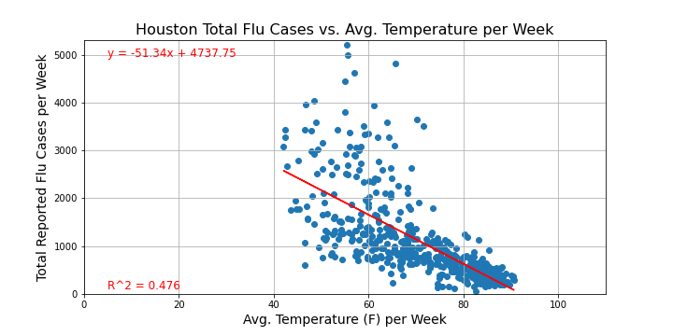
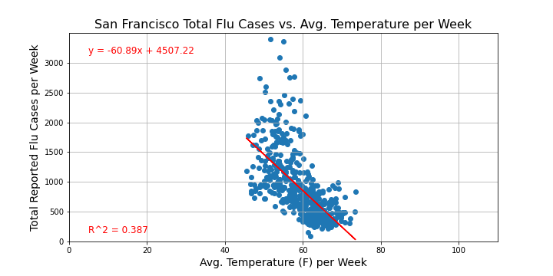
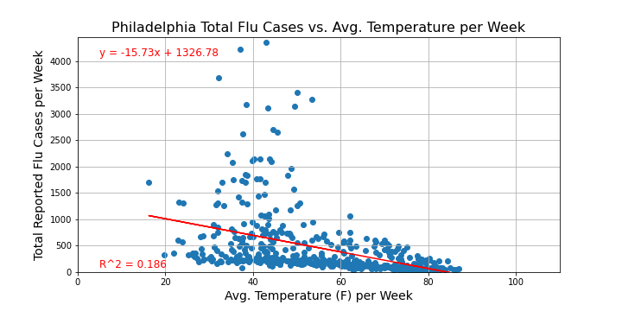

Slide 9
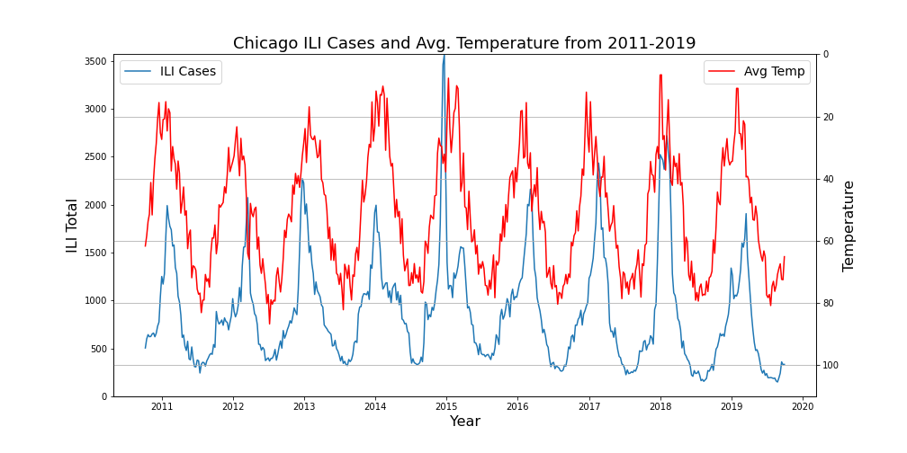
Time Series
Time Series Visually helps to show Seasonal peaks relationship
Flu Season tends to peak a couple weeks after winter
An auto-correlation study would help confirm this

Slide 10
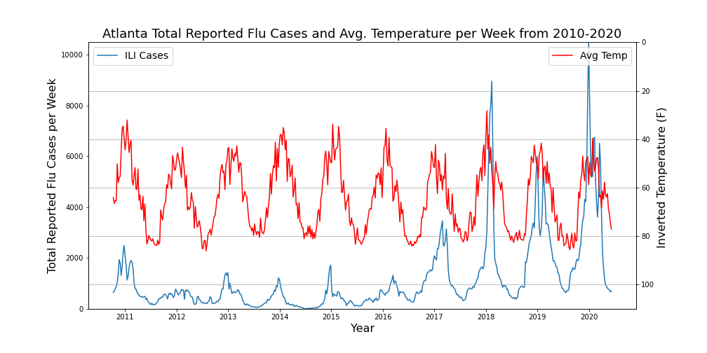
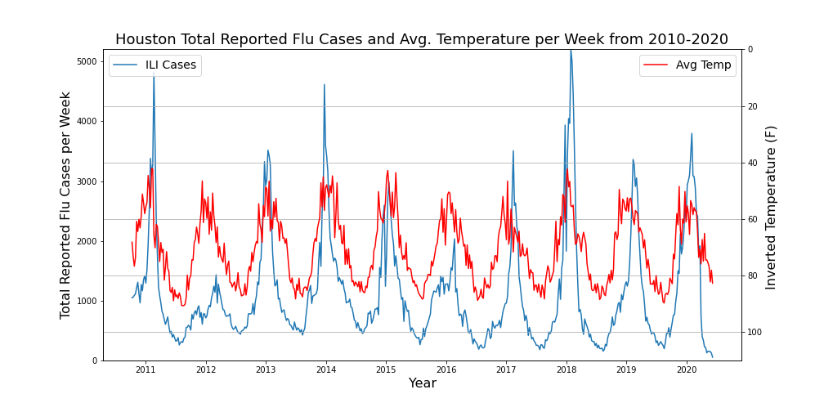
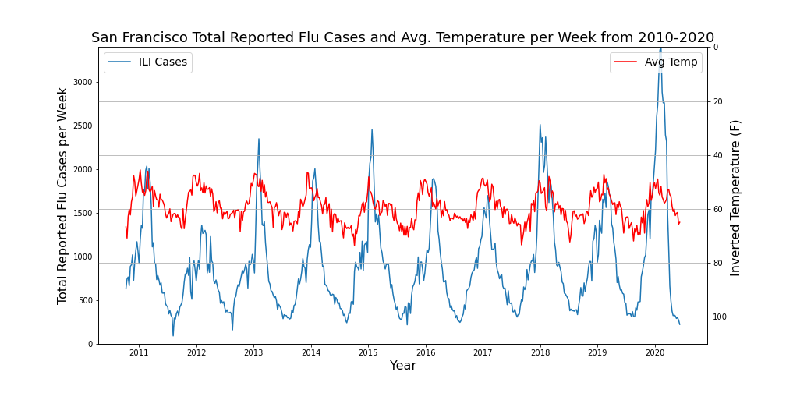
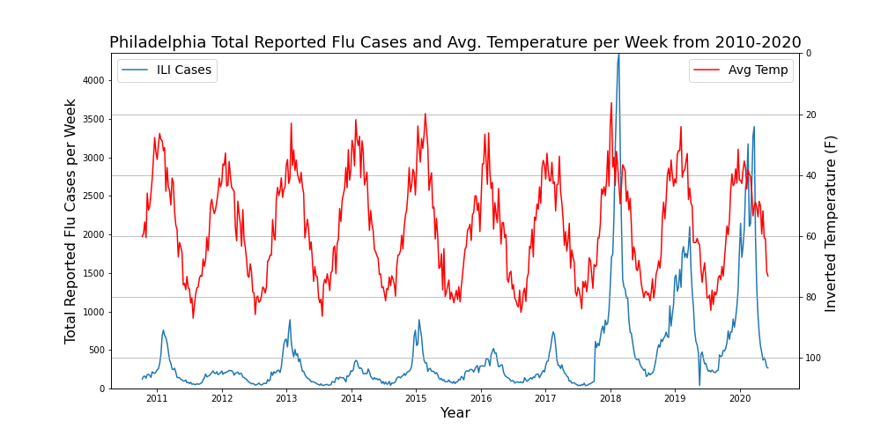

Slide 11
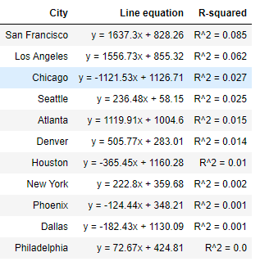
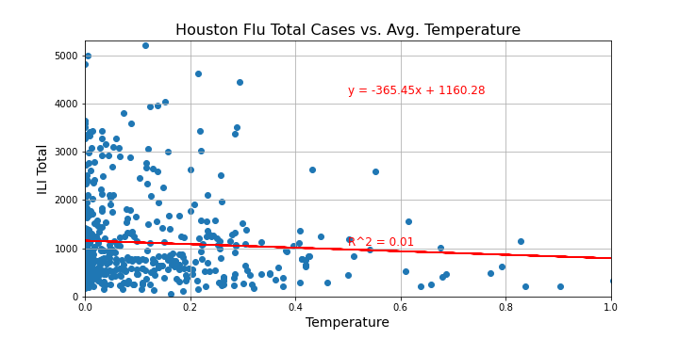
Comparing Other Weather Data
We ran the same comparison with the Flu ILI data and Precipitation
No/very little relationship between precipitation and Flu cases

Slide 12
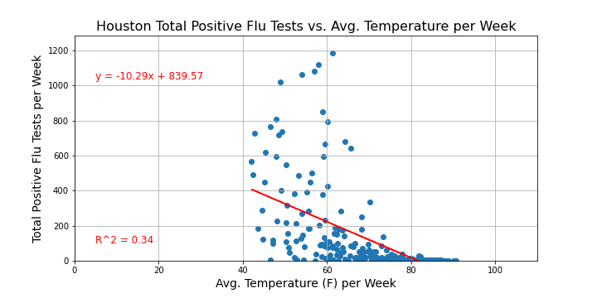
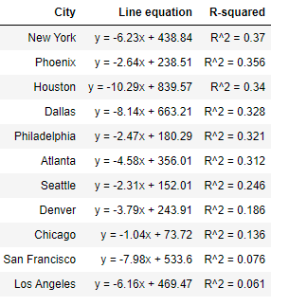
Flu Positive Test Cases
CDC/WHO published positive cases. We compared total positive cases to temperature data
Positive cases confirmed the relationship we saw in total cases

Slide 13
Conclusion
A clear relationship exist between colder temperatures and Flu season

Slide 14
Post Mortem
Discuss any difficulties that arose, and how you dealt with them
Discuss any additional questions that came up, but which you didn’t have time to answer: What would you research next, if you had two more weeks?

Slide 15

Questions?

